Slide 1

Getting started with NoSQL in .NET using RavenDB
Ondrej Balas @ondrejbalas

Slide 2
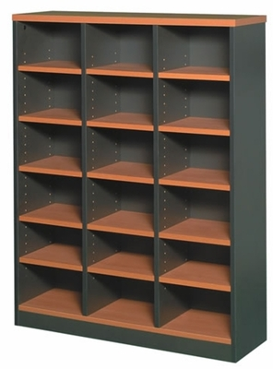



It’s a Document Database!
Any type of object can be stored
Serializes to JSON
Notes:
Store Documents instead of Rows, and Collections instead of Columns

Slide 3
It’s a Document Database!
Any type of object can be stored
Serializes to JSON
{
"Id": "Customers/1",
"Name": "Emily",
"Address": "123 Oak St",
"City": "Boston",
"PrefferedCustomer": true
}
{
"Id": "Products/1",
"Name": "Ice Cream",
"Price": 4.25
}
{
"Id": "Products/2",
"Name": "Book with Lamp",
"Price": 89.95
}
Notes:
Store Documents instead of Rows, and Collections instead of Columns

Slide 4


It’s a Document Database!
Any type of object can be stored
Serializes to JSON
Notes:
Store Documents instead of Rows, and Collections instead of Columns

Slide 5
Example: Storing a Blog
class BlogPost
{
public string Title { get; set; }
public List<string> Tags { get; set; }
}

Slide 6
Storing a Blog Post
BlogPosts
blog_id | title
1 | Raving about Raven
BlogTags
blog_id | tag_id
1 | 1
1 | 2
Tags
tag_id | tag_text
1 | ravendb
2 | ondrej

Slide 7
Storing a Blog Post
BlogPosts
blog_id | title
1 | Raving about Raven
BlogTags
blog_id | tag_id
1 | 1
1 | 2
Tags
tag_id | tag_text
1 | ravendb
2 | ondrej

Slide 8
Storing a Blog Post
BlogPosts
blog_id | title
1 | Raving about Raven
BlogTags
blog_id | tag_id
1 | 1
1 | 2
Tags
tag_id | tag_text
1 | ravendb
2 | ondrej

Slide 9
Storing a Blog Post
{
"Title": "Raving about Raven",
"Tags": [
"ravendb",
"ondrej"
]
}

Slide 10
Storing a Blog Post
RavenDB
{
"Title": "Raving about Raven",
"Tags": [
"ravendb",
"ondrej"
]
}
SQL Equivalent
Raving about Raven
ravendb
ondrej

Slide 11
Storing a Blog Post
RavenDB
{
"Title": "Raving about Raven",
"Tags": [
"ravendb",
"ondrej"
]
}
SQL Equivalent
BlogPosts
blog_id | title
1 | Raving about Raven
BlogTags
blog_id | tag_id
1 | 1
1 | 2
Tags
tag_id | tag_text
1 | ravendb
2 | ondrej

Slide 12




The Castle Project
Oren Eini
(Ayende)
Notes:
Cascading deletes – customer profile with notes

Slide 13
ORM Object-relational mapper

Slide 14
Impedance Mismatch
Relational model
Tables, Columns, Rows
Object model
Objects

Slide 15
Select N+1
A Customer with 10 orders
Hand-written SQL
SELECT * FROM CUSTOMERS INNER JOIN ORDERS ON CUSTOMER.ID = ORDER.ID WHERE CUSTOMER.ID = x;
Possible ORM-generated SQL
SELECT * FROM CUSTOMERS WHERE CUSTOMER.ID = x; SELECT * FROM ORDERS WHERE ORDER.ID = 123; SELECT * FROM ORDERS WHERE ORDER.ID = 124; SELECT * FROM ORDERS WHERE ORDER.ID = 125; # ETC..

Slide 16


Slide 17
Performance
SQL is optimized for WRITEs
RavenDB is optimized for READs

Slide 18
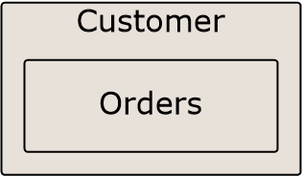
Think Aggregates

Slide 19
Reporting

Slide 20
Let’s get started!

Slide 21
Setting up a Server
NuGet
or
http://ravendb.net

Slide 22
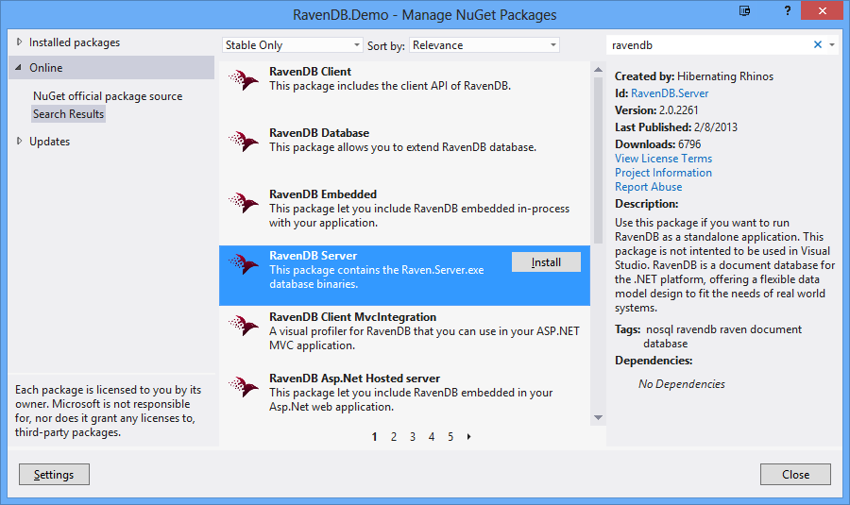
RavenDB Server on Nuget

Slide 23
Interesting Parts
1 Backup

Slide 24
Interesting Parts
1 Backup
1 Bundles

Slide 25
Interesting Parts
1 Backup
1 Bundles
1 Client

Slide 26
Interesting Parts
1 Backup
1 Bundles
1 Client
1 EmbeddedClient

Slide 27
Interesting Parts
1 Backup
1 Bundles
1 Client
1 EmbeddedClient
1 Samples

Slide 28
Interesting Parts
1 Backup
1 Bundles
1 Client
1 EmbeddedClient
1 Samples
1 Server

Slide 29
Interesting Parts
1 Backup
1 Bundles
1 Client
1 EmbeddedClient
1 Samples
1 Server
1 Smuggler

Slide 30
Interesting Parts
1 Backup
1 Bundles
1 Client
1 EmbeddedClient
1 Samples
1 Server
1 Smuggler
3 Start.cmd

Slide 31
Interesting Parts
1 Backup
1 Bundles
1 Client
1 EmbeddedClient
1 Samples
1 Server
1 Smuggler
3 Start.cmd

Slide 32
Inside the Server folder
3 Raven.Server.exe
3 Raven.Server.exe.config
1 Data
1 Logs
1 Tenants
Notes:
Looks scary, but only

Slide 33
Inside the Server folder
3 Raven.Server.exe
3 Raven.Server.exe.config
1 Data
1 Logs
1 Tenants
Notes:
Looks scary, but only

Slide 34
Configuration File
<appSettings>
<add key="Raven/Port" value="*"/>
“*” Or a number; “*” means port 8080 or next available
<add key="Raven/DataDir" value="~\Data"/>
<add key="Raven/AnonymousAccess" value="Get"/>
Options are Get, All, and None
</appSettings>

Slide 35
More options
Raven/MaxPageSize (Default: 1024)
Raven/RunInMemory (Default: false)
Raven/TransactionMode (Default: Safe) (Lazy = Can lose data on crash)
Raven/HostName (Default: None)
Raven/PluginsDirectory (Default: “~\Plugins”)

Slide 36
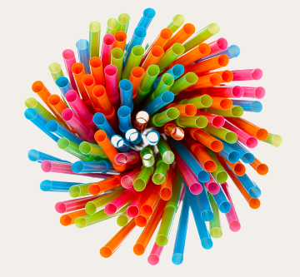
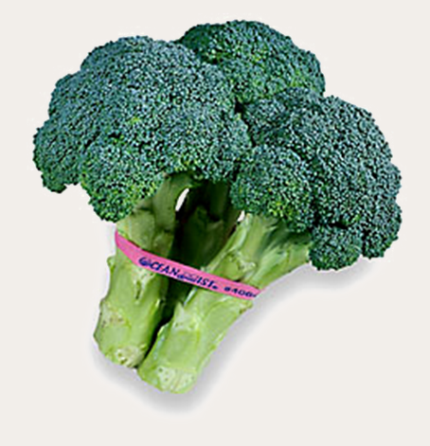
Bundles!
Sharding & Replication
Expiration
Versioning
More Like This
Unique Constraints

Slide 37
Now for the fun stuff
Notes:
Demo time!!!!

Slide 38
Index: Temp/Products/ByCategory
Categories Documents
Office Supplies
products/Stapler
Furniture
products/Tape
products/Paper
products/Chair
products/Desk

Slide 39
Transactions
Implicit or Explicit
Atomic, Isolated, and Durable
Eventual Consistency
Immediate Consistency Possible

Slide 40
Consistency - Load vs. Query
Indexes can be stale
Use load for immediate consistency
Take advantage of Id naming

Slide 41
Query without Querying
session.Advanced
.LoadStartingWith<BlogPost>
("blogposts/2012-10");
session.Load<BlogPost>(Enumerable.Range(10, 7)
.Select(i =>
string.Format("2012-10-{0:00}", i)));

Slide 42
Handling Schema Changes
Adding Properties
Removing Properties
Modifying Properties

Slide 43
Adding Properties
Add to model
Set it in the constructor

Slide 44
Removing Properties
Remove it from your model
RavenDB will self-cleanse

Slide 45
Modifying Properties
Load, change, and store each object
Use the Patch API
Extension point: IDocumentConversionListener

Slide 46
Safe by Default
Unbounded result sets
Unbounded number of requests
Notes:
Page size is 128 if unspecified, and 1024 is default maximum || 30 requests per session maximum

Slide 47
Licensing
http://ravendb.net/licensing Mar 1, 2013
Free for Development
Free for Open Source
Commercial Use recently changed status to “It’s Complicated”
Still much cheaper than SQL Server

Slide 48
Ready to play?
Check out the Sample Data

Slide 49
Thanks! Resources http://bit.ly/RavenLinks
Questions? Find me at:
Twitter - @ondrejbalas
Blog - ondrejbalas.com
ondrej@ondrejbalas.com
Notes:
Hope I’ve inspired you.

